Slide 2
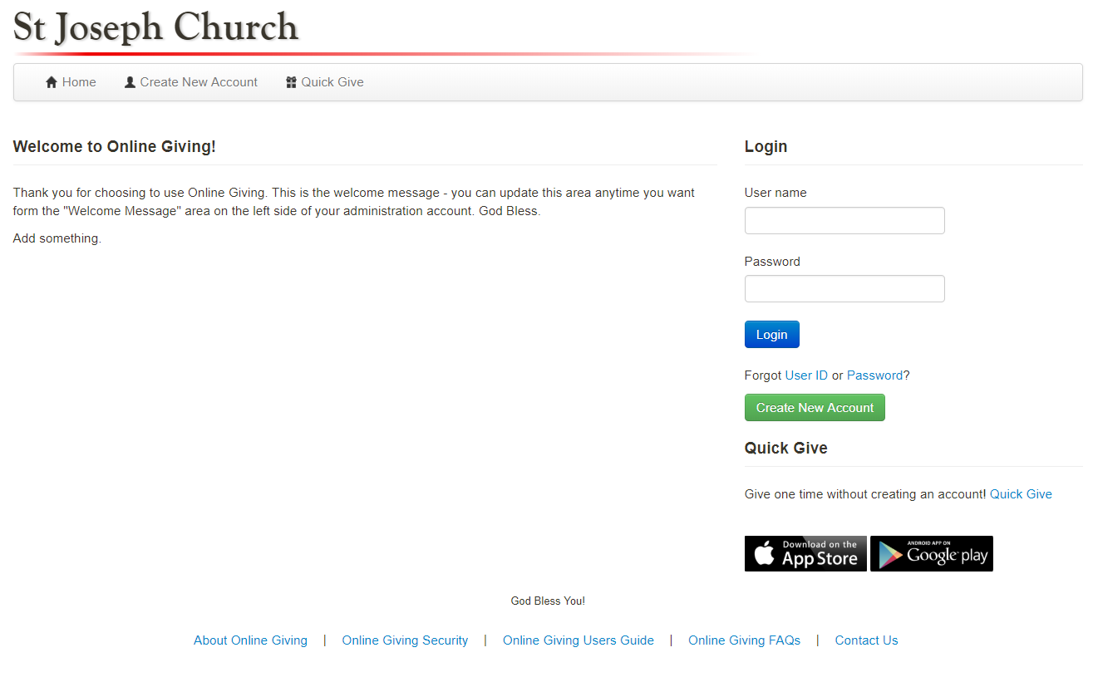
Go to the parish website and select the Online Giving Icon.
Once you are on the Online Giving Page, select create new account.
Creating an Online Giving Account is simple and convenient!

Slide 3
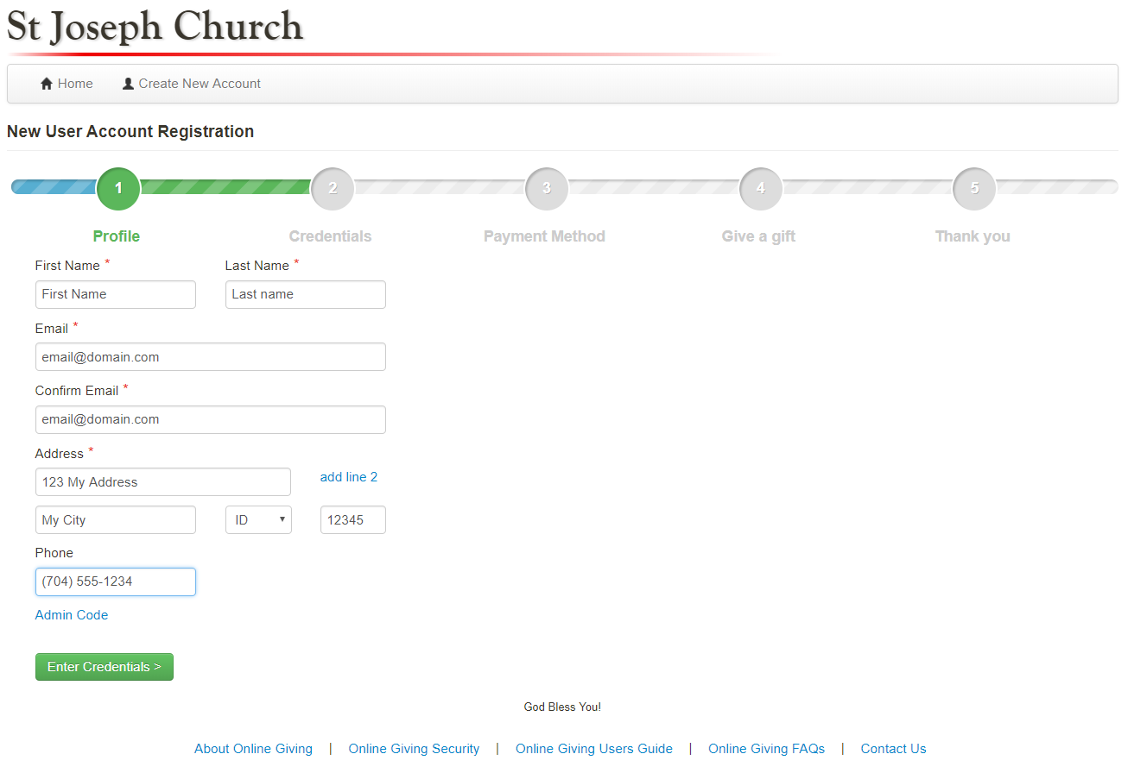
This will bring you to the Donor Signup Wizard.
Complete your profile information.
This will bring you to the donor sign up wizard.
Complete your profile information.

Slide 4
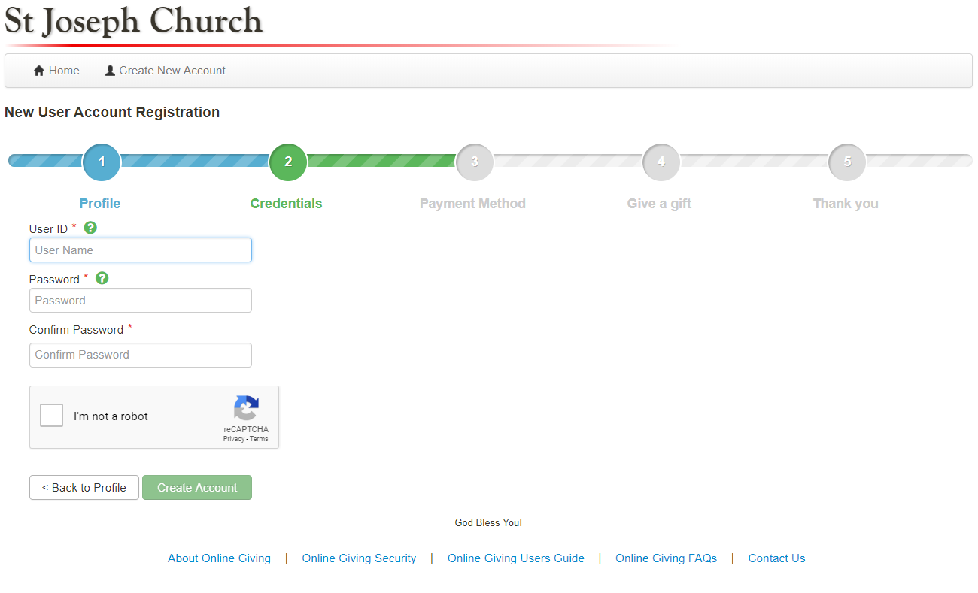
Simply create a User Name and Password
This will bring you to the donor sign up wizard.
Complete your profile information.

Slide 5
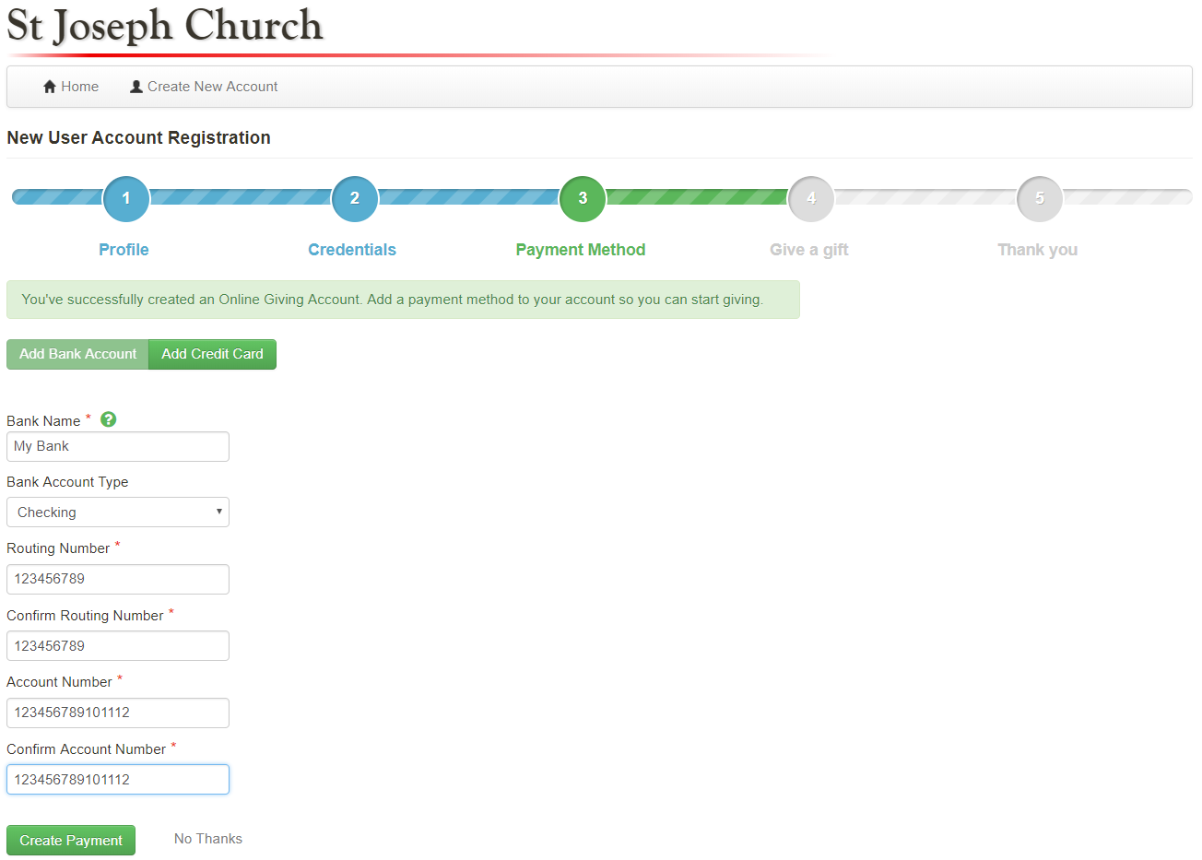
Enter your preferred payment method
This will bring you to the donor sign up wizard.
Complete your profile information.

Slide 6
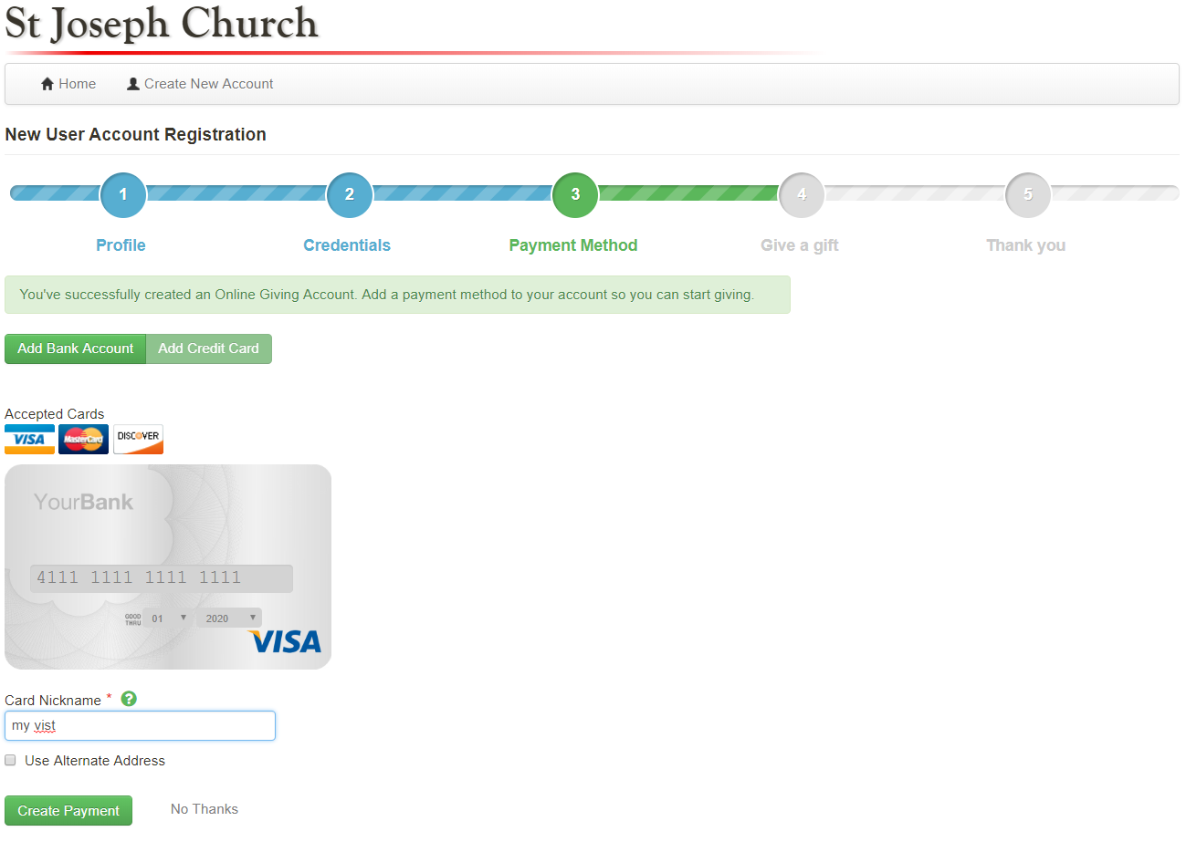
Depending on your Parish you may select bank account or credit card
This will bring you to the donor sign up wizard.
Complete your profile information.

Slide 7
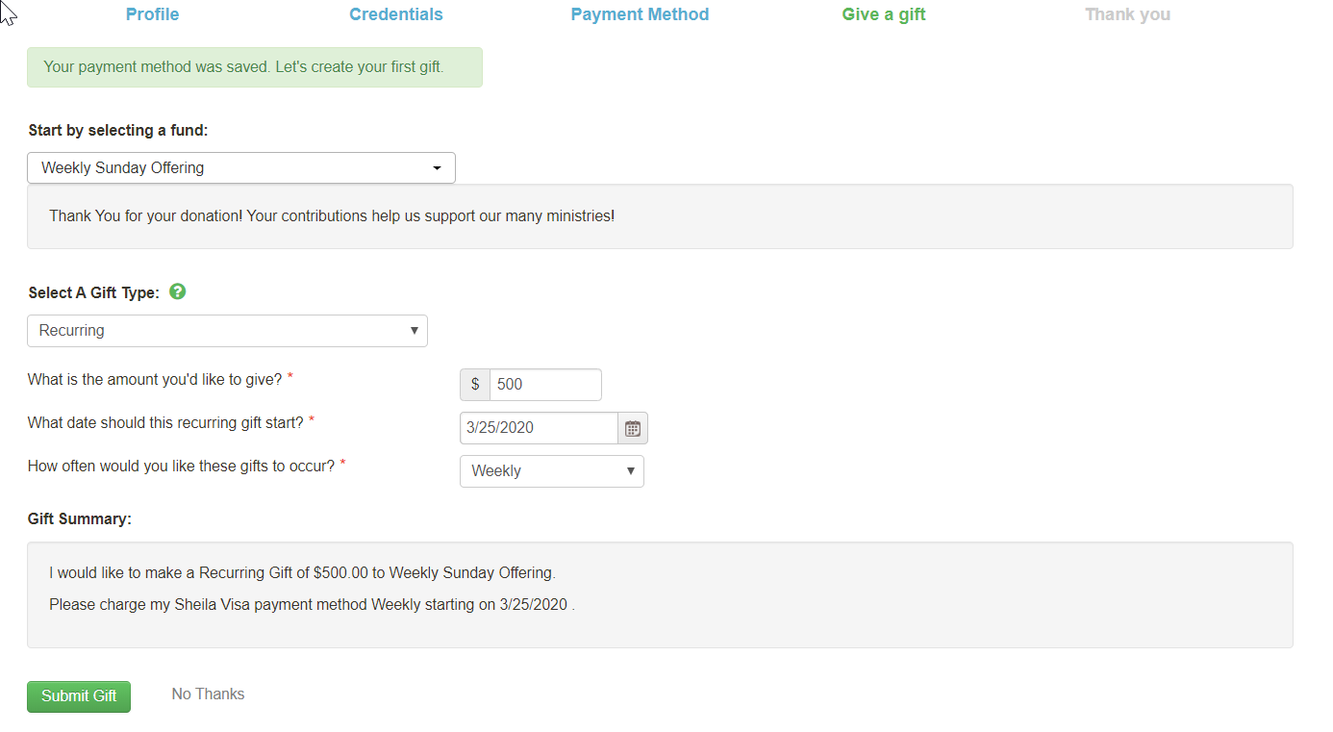
Add your first recurring donation and then select submit gift
This will bring you to the donor sign up wizard.
Complete your profile information.

Slide 8
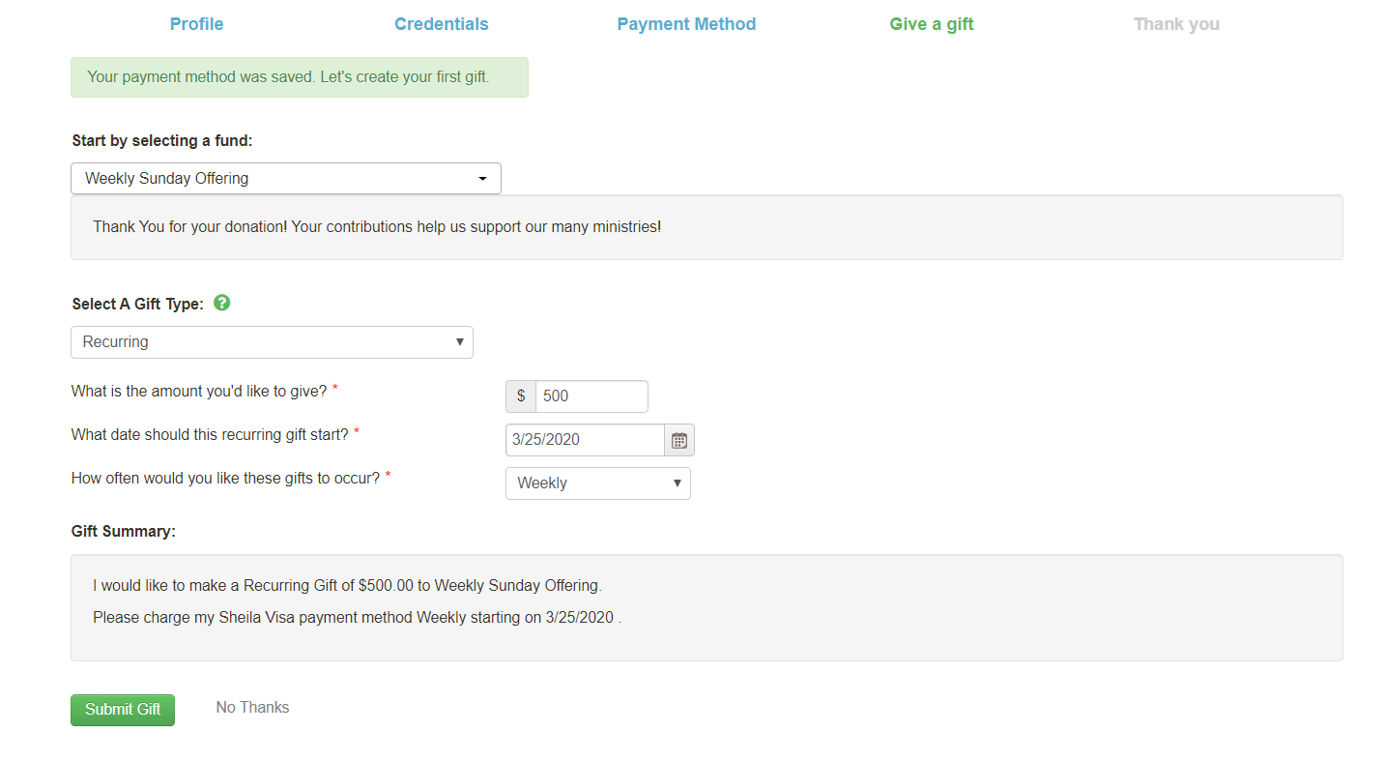
Add your first recurring donation and then select submit gift
This will bring you to the donor sign up wizard.
Complete your profile information.

Slide 9
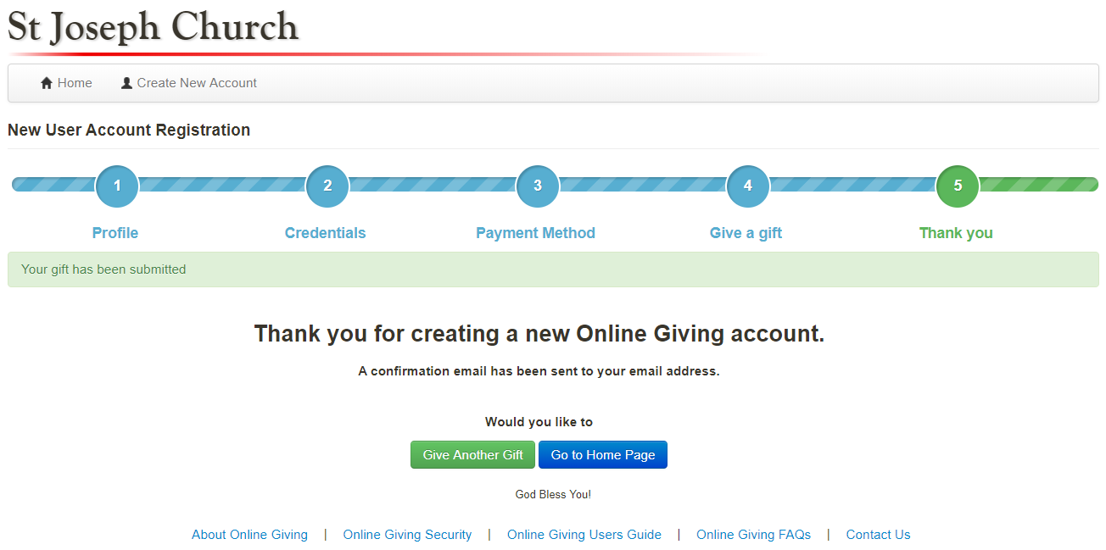
Select “Give Another Gift” to give to additional funds.
You will receive an email confirmation regarding your recurring donation!
This will bring you to the donor sign up wizard.
Complete your profile information.

Slide 10
This will bring you to the donor sign up wizard.
Complete your profile information.
THANK YOU FOR YOUR DONATION!!

